Slide 1

1st Vice State Director Report
Brother Patrick Owens
LM 3968

Slide 2

EOY Membership Numbers
We ended the 2025 year with 664 brothers in Mississippi
Year | Total Brothers | Graduate | Undergraduate | Transient | Life Members
2025 | 664 | 531 | 109 | 24 | 64
We ended with 29 active chapters. Of the 29 chapters, 10 are undergraduate and 19 are graduate.

Slide 3
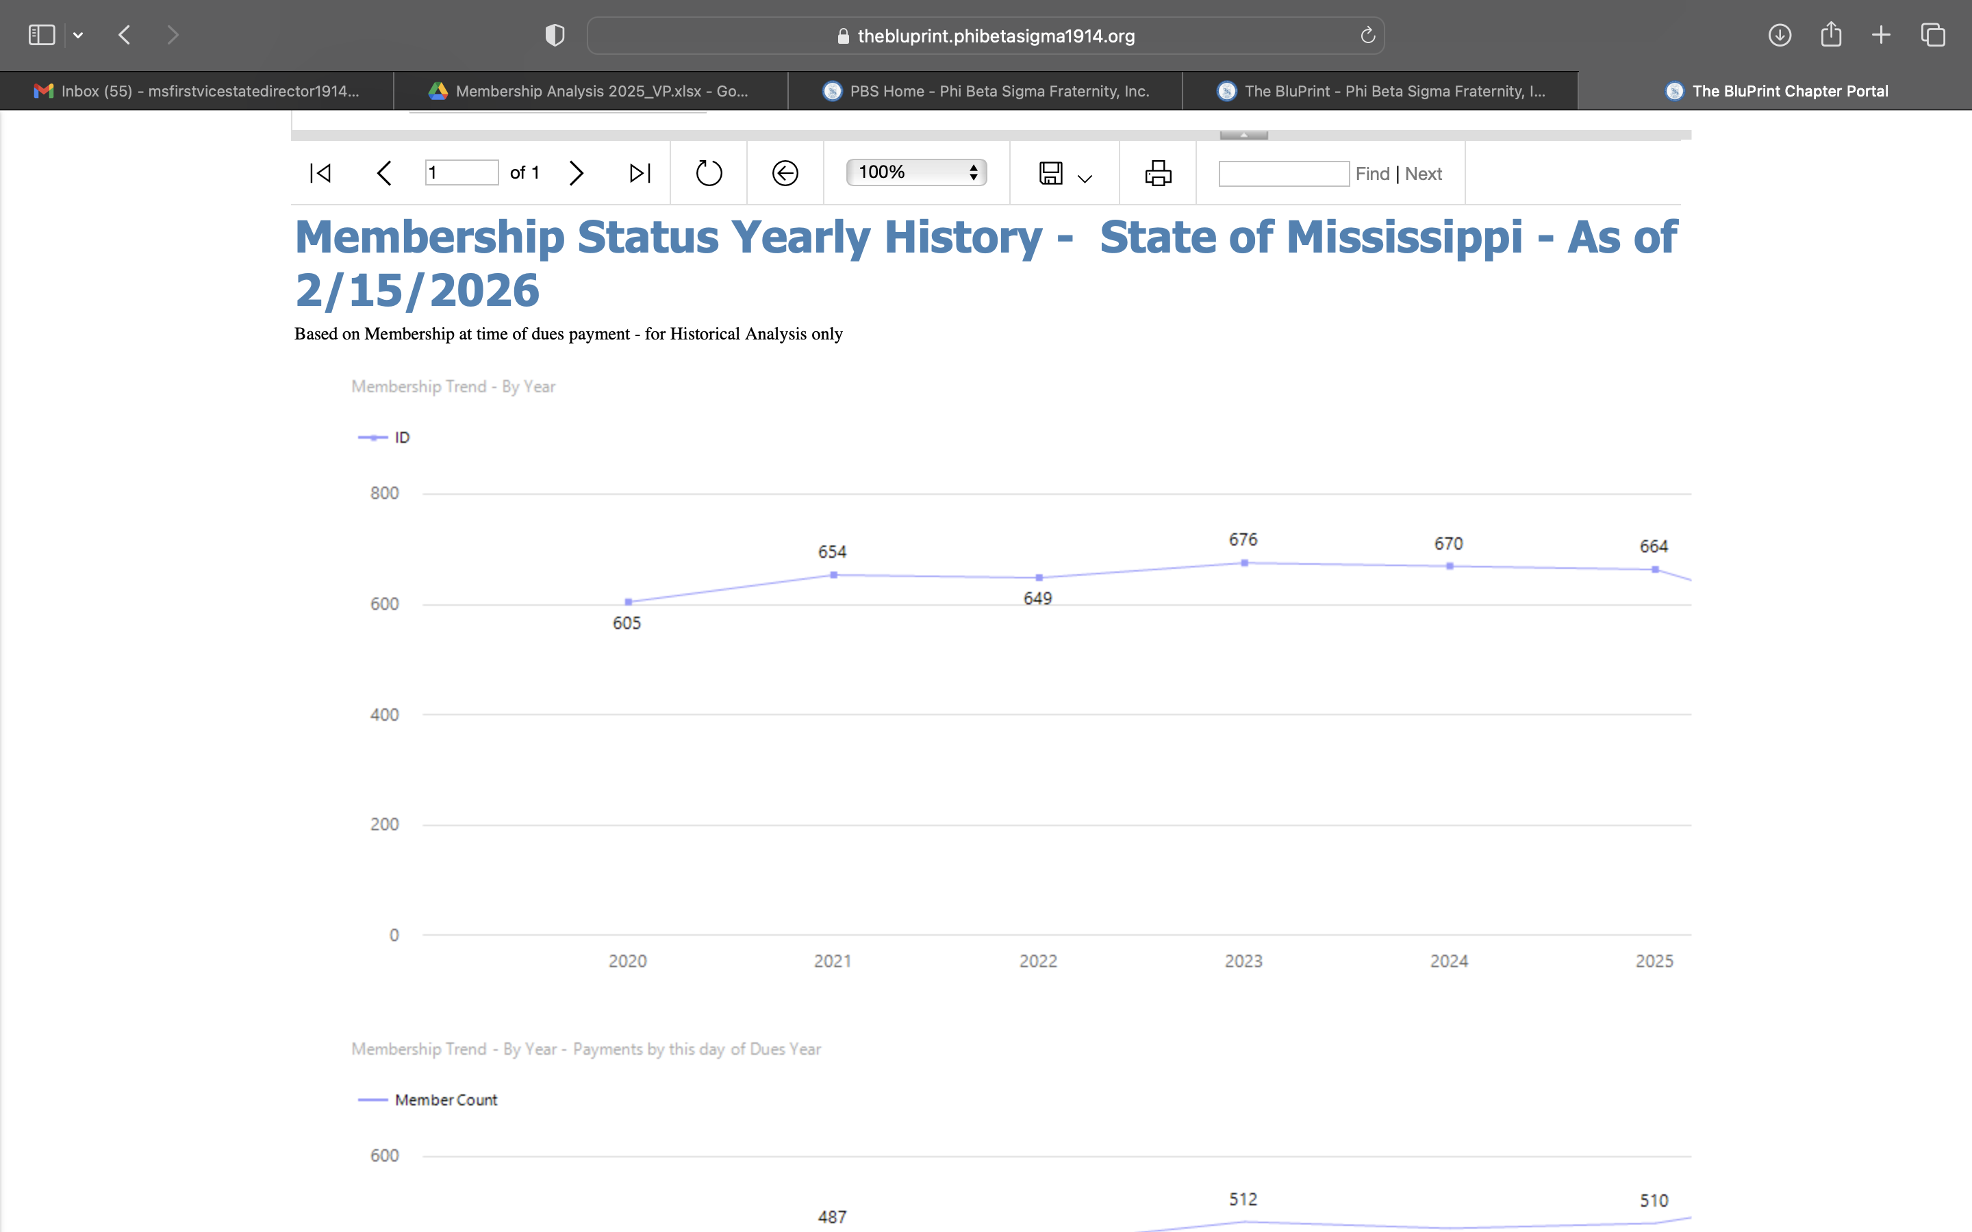
Membership Trends

Slide 4
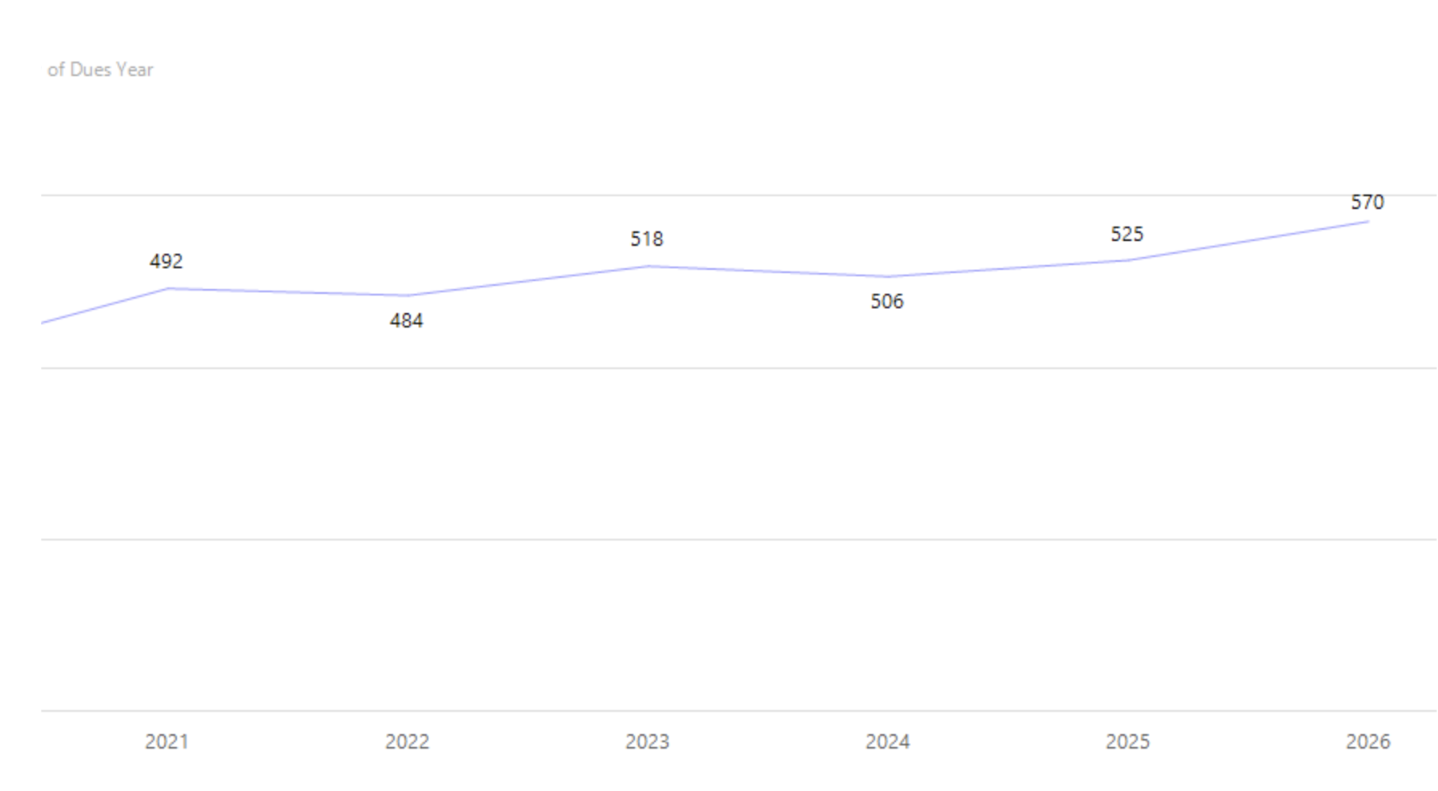
Membership Trends
Membership Trends – As of this day

Slide 5
Largest Chapter
Undergraduate Chapter
  Theta Eta Chapter
Graduate Chapter
  Mu Sigma Chapter
As of February 15, 2026
  Largest Undergraduate Chapter – Alpha Beta Chapter & Theta Eta Chapter
  Largest Graduate Chapters - Mu Sigma

Slide 6
Retention of 100% or End of the Year Growth
Undergraduate Chapters
  Alpha Beta +9
  Alpha Zeta +6
  Beta Rho +2
  Delta Phi =
  Eta Beta +3
  Gamma Psi +3
  Theta Eta +7
  Theta Iota +2
  Xi Beta =
Graduate Chapters
  Alpha Iota Sigma +3
  Delta Phi Sigma =
  Eta Eta Sigma +1
  Iota Rho Sigma +4
  Kappa Epsilon Sigma +2
  Lambda Epsilon Sigma =
  Pi Alpha Sigma +1
  Pi Omicron Sigma +2
  Theta Iota Sigma =
  Upsilon Kappa Sigma +13

Slide 7
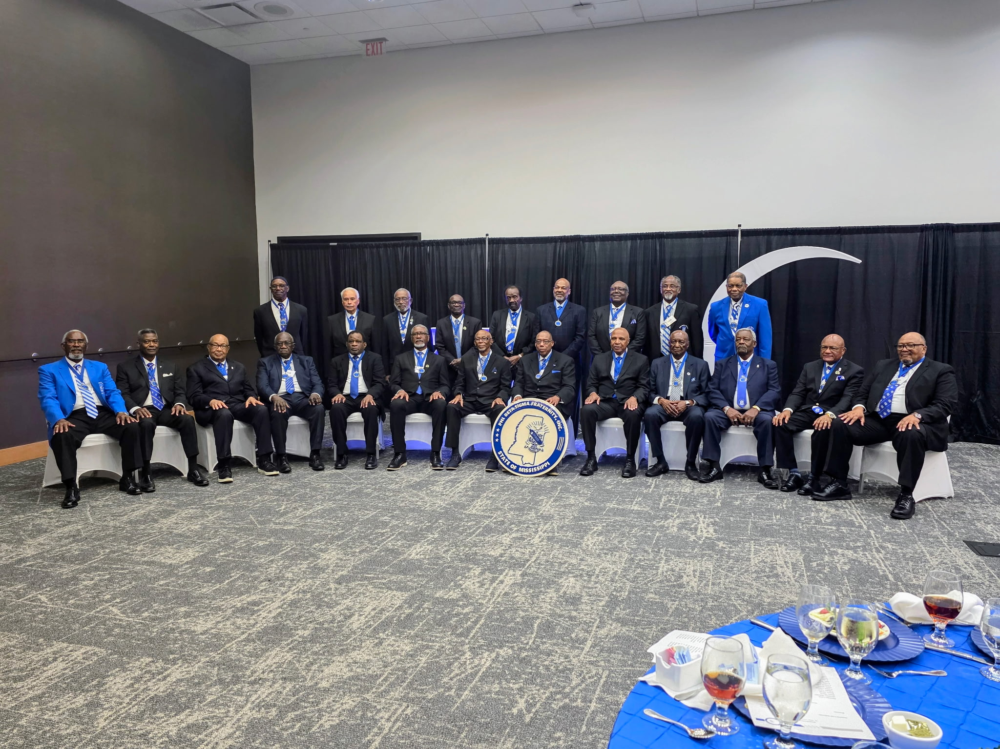
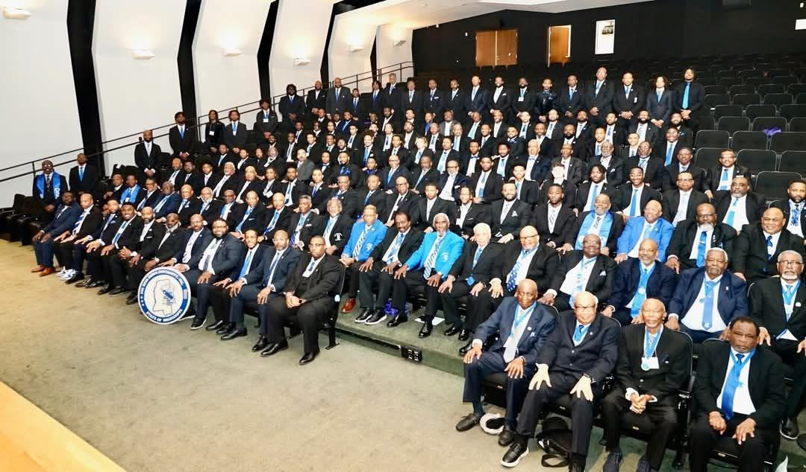
Year in Membership
State of Mississippi
Magnolia Club
Mississippi Sigma’s in Action

Slide 8
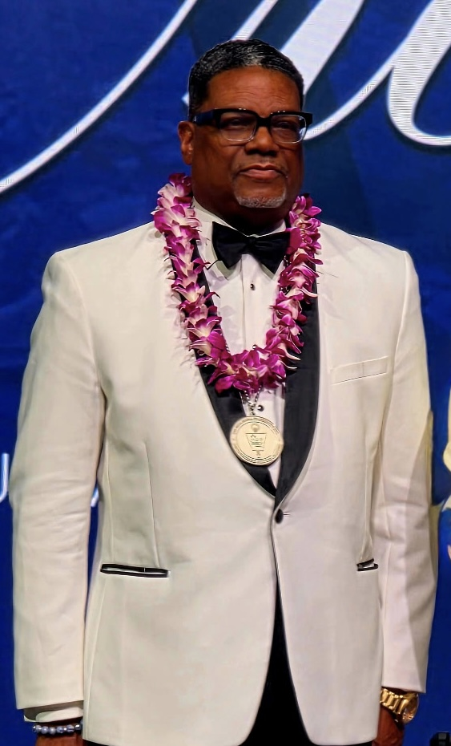
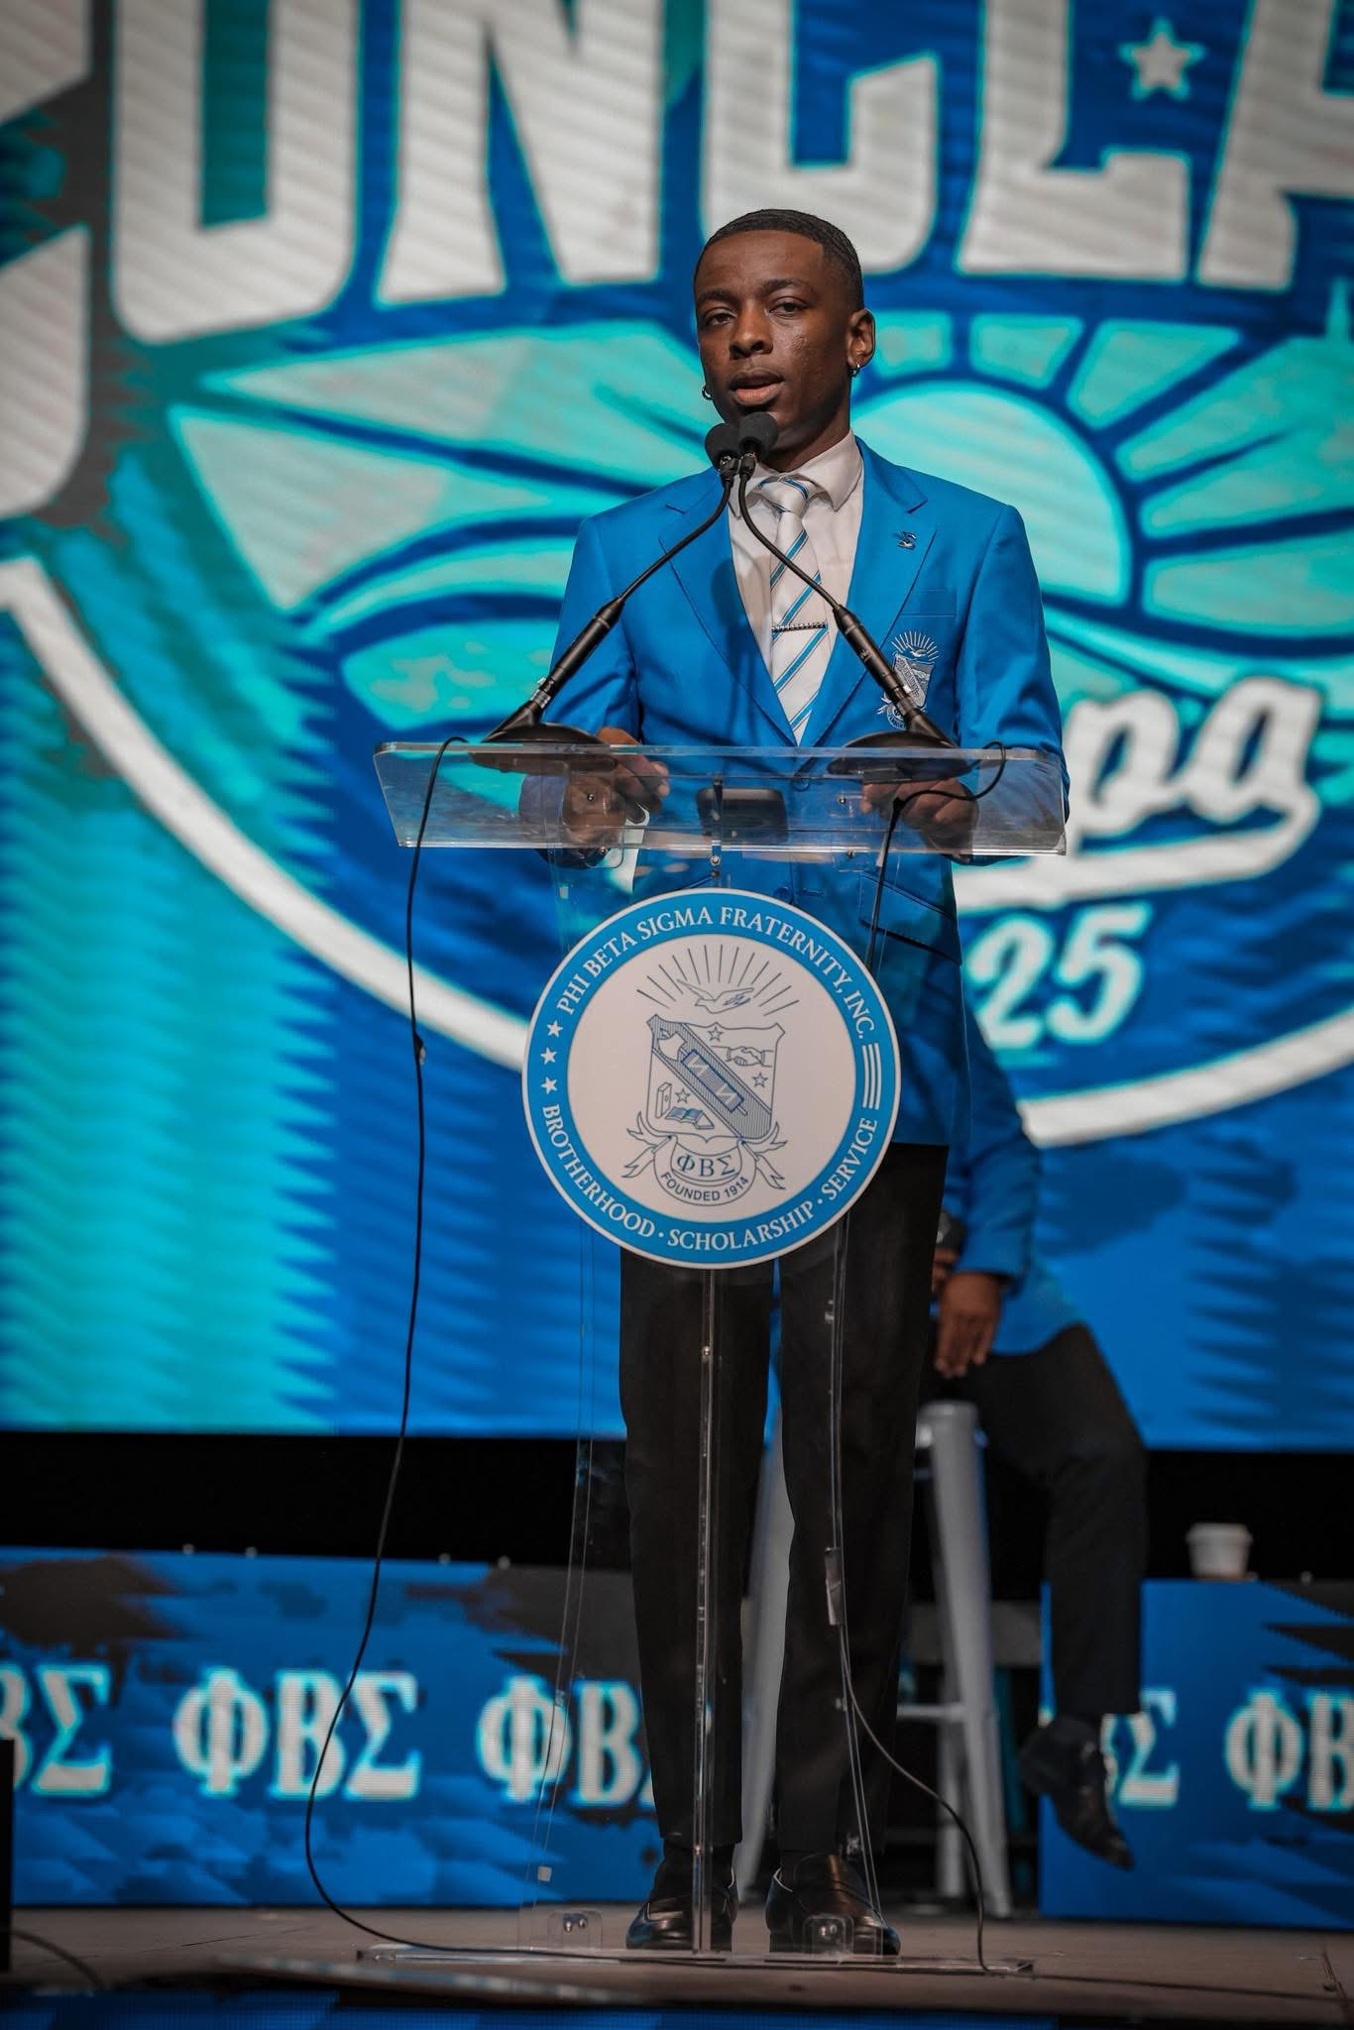
Year in Membership
Honorable Marcus A. Chaney, Ph.D
DSC # 207
Mu Sigma Chapter
Bro. Devean Bush
International 2nd Vice President
Alpha Beta Chapter

Slide 9
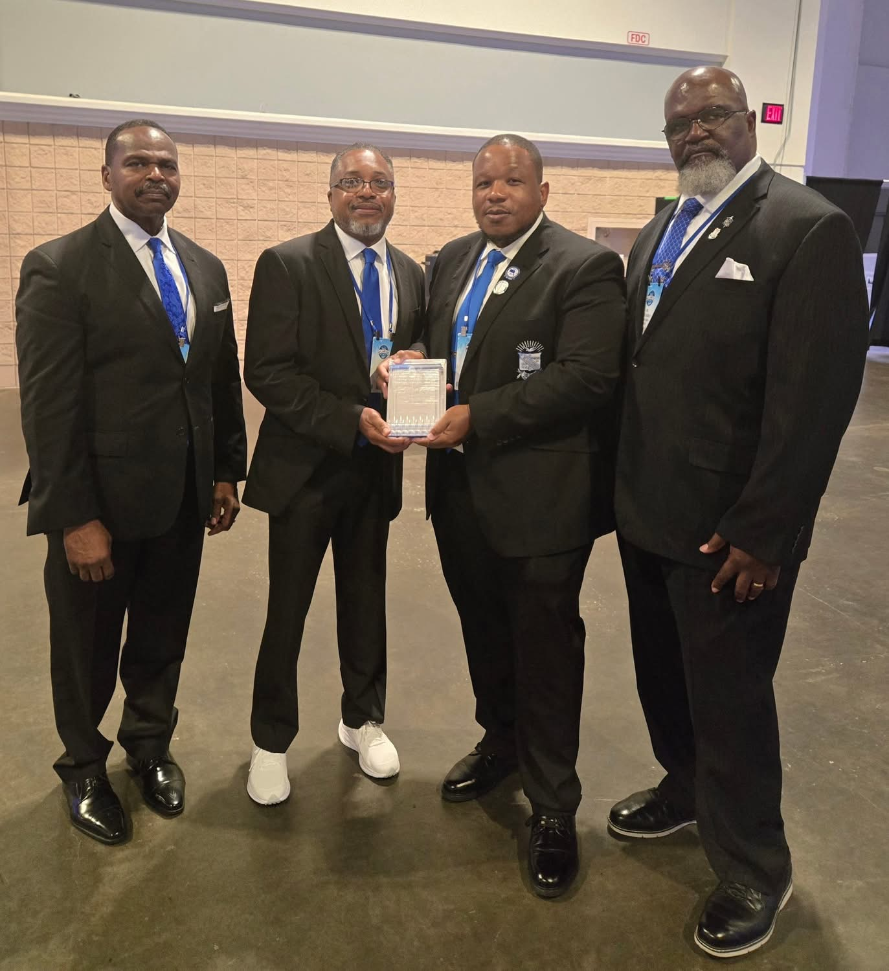

Year in Membership
Theta Iota Sigma Chapter
Phi Beta Sigma Conclave Model Alumni Chapter – Bronze Level
Theta Eta Chapter
International Bigger & Better Business
Collegiate Chapter of the Year

Slide 10
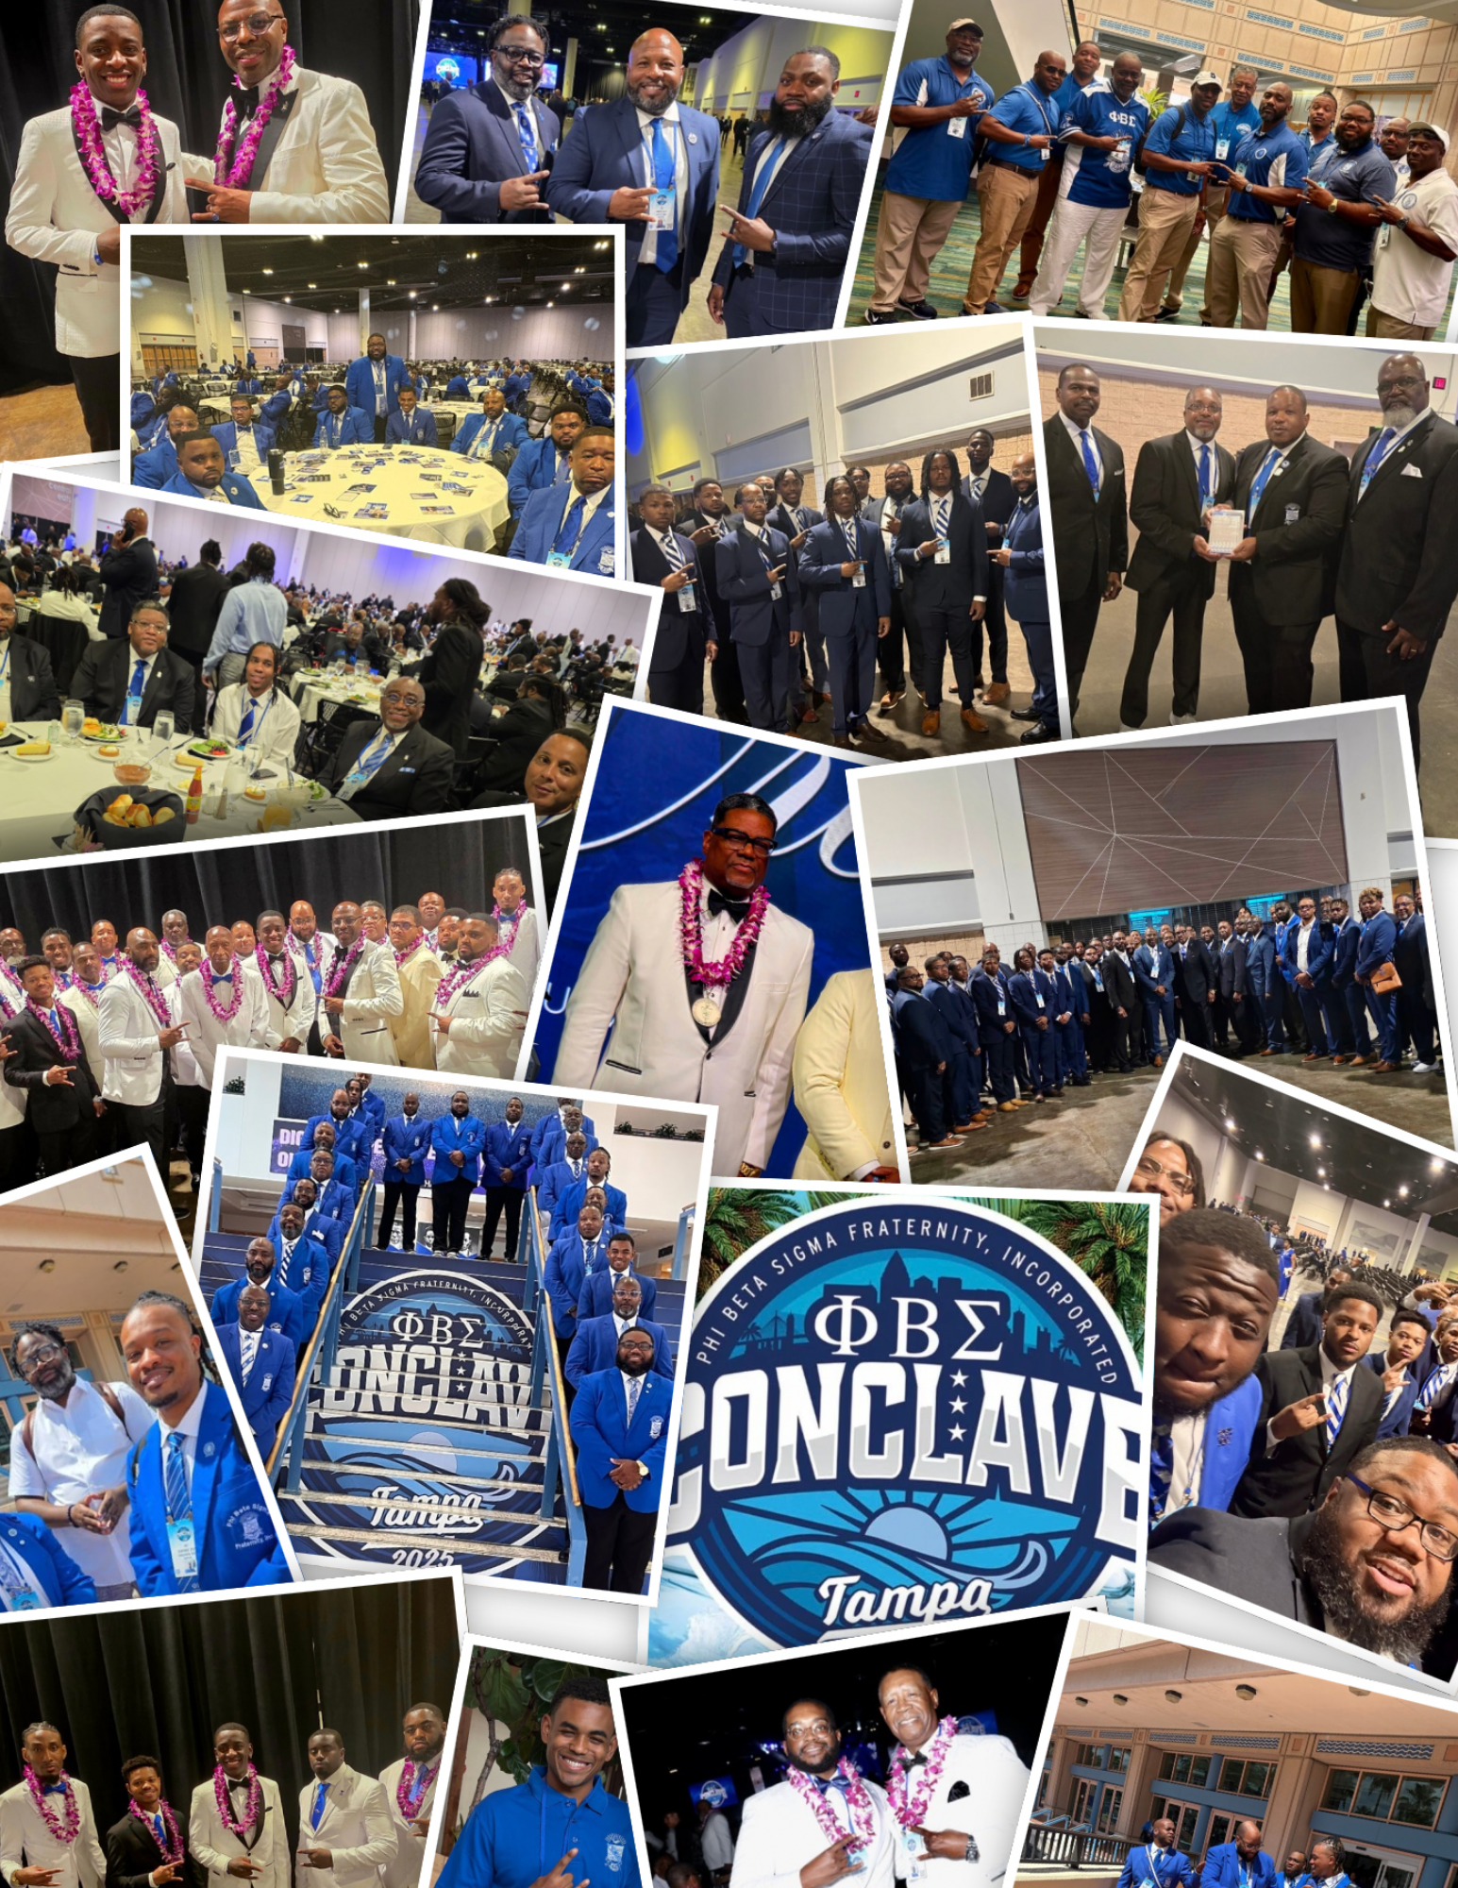
Year In Membership
Welcome 1st time State Conference Attendees
Congratulations to Brothers w/ Milestones
Congratulations New Life Members
Congratulations to the Magnolia Club Inductees

