Slide 1
MEMBERSHIP INTAKE PROCESS UPDATES
Shermaine Sullivan
Mu Sigma
Southern Regional Director of Collegiate Affairs
Collegiate.affairs@pbssouthern.org

Slide 2
WHAT TODAY IS NOT
MIP CERTIFICATION >>>> TAKEN IN BLUPRINT ANNUALLY
RISK MANAGEMENT >>>> TAKEN IN BLUPRINT ONCE
THE DAY TO CHANGE >>>> GREAT DAY TO HEAR CONCERNS

Slide 3
WARM UP QUIZ
HOW LONG BEFORE YOU BEGIN MIP SHOULD THE PBS-7C BE SUBMITTED?
DO YOU NEED TO TAKE AN ACTION IF YOU CHANGE A MODULE DATE FROM APPROVED PBS-7C?
WHEN SHOULD YOU PAY MIP FEES IN BLUPRINT?
DO BROTHERS HAVE TO REMAIN MIP CERTIFIED THROUGHOUT THE PROCESS?
WHEN IS THE CRESCENT CEREMONY PERFORMED?

Slide 4
QUIZ RESULTS
HOW LONG BEFORE YOU BEGIN MIP SHOULD THE PBS-7C BE SUBMITTED? 14-28 DAYS
DO YOU NEED TO TAKE AN ACTION IF YOU CHANGE A MODULE DATE FROM APPROVED PBS-7C? UPDATE PBS-7C
WHEN SHOULD YOU PAY MIP FEES IN BLUPRINT? MODULE 1
DO BROTHERS HAVE TO REMAIN MIP CERTIFIED THROUGHOUT THE PROCESS? START TO FINISH
WHEN IS THE CRESCENT CEREMONY? START OF MODULES

Slide 5
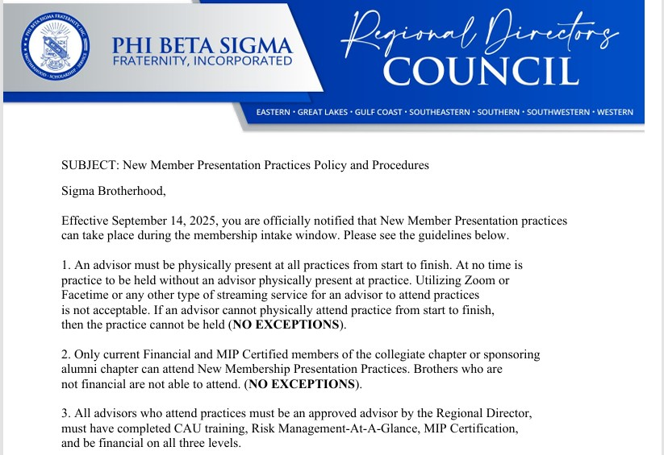

Slide 6
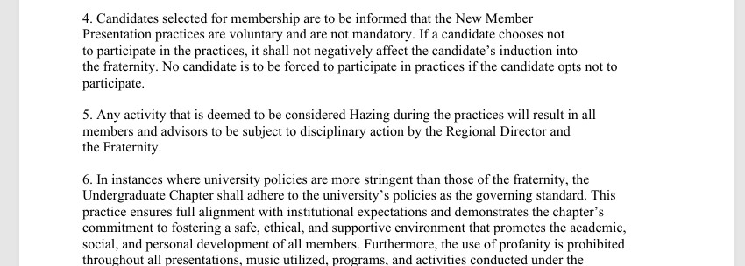

Slide 7
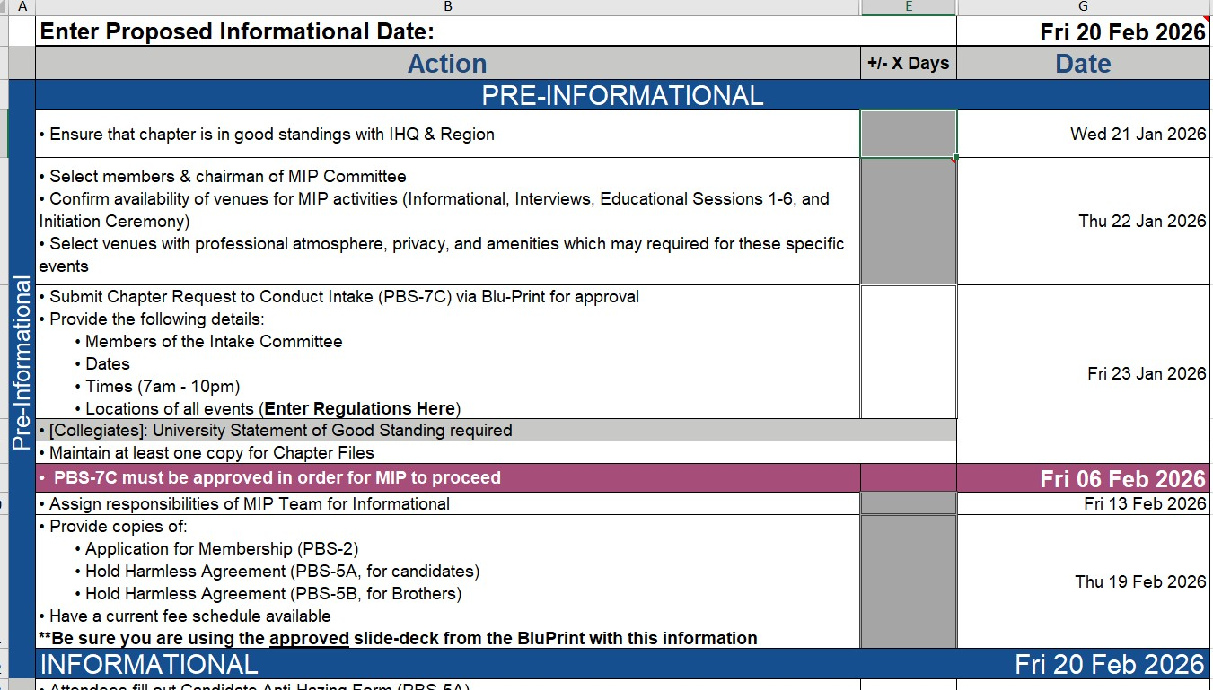

Slide 8
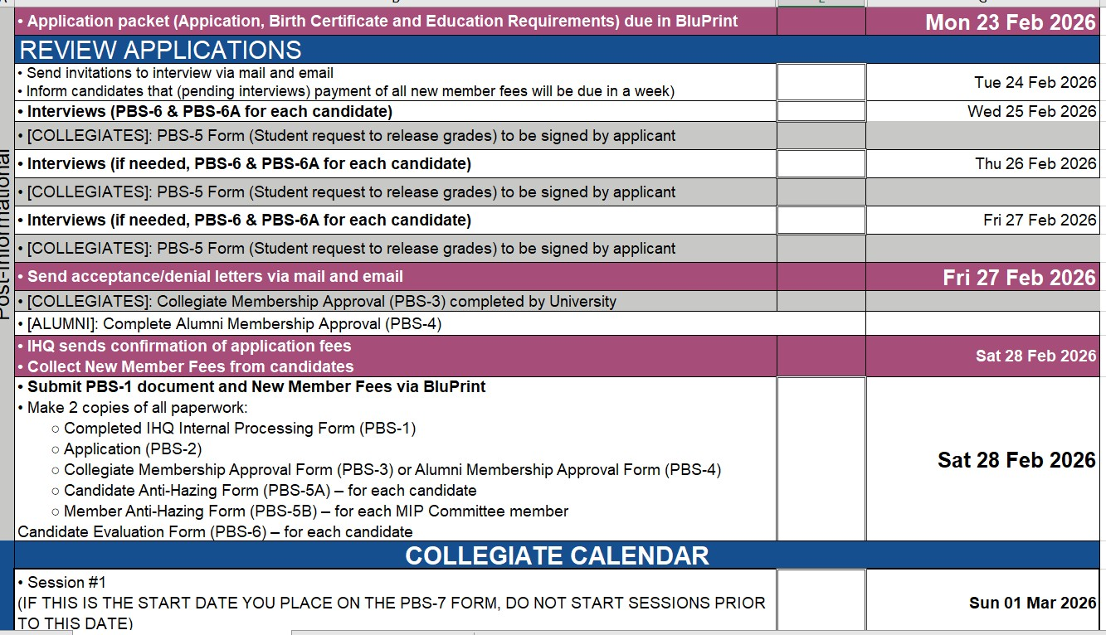

Slide 9
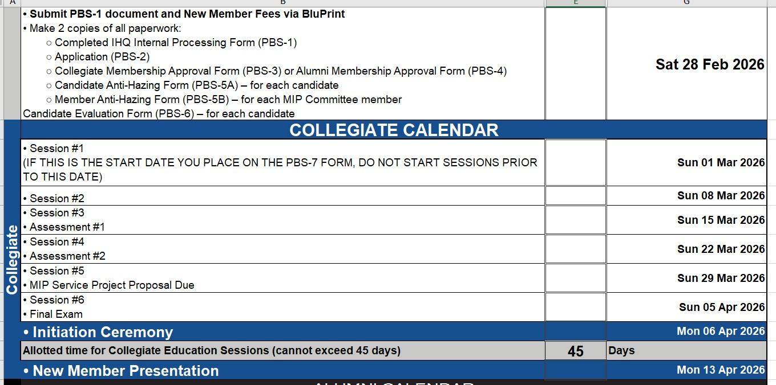

Slide 10
CLOSING THOUGHTS
COLLEGIATES – WE ARE AT THE SCHOOL BY GRACE NOT RIGHT
ALUMNI – BEING AN ADVISOR MEANS SEEING YOU MORE THAN ONCE A MONTH
PBS-2 PRINT LEGIBLY OR TYPE IT

Slide 11

QUESTIONS
This Photo by Unknown Author is licensed under CC BY-SA

Slide 12


