Slide 1

State Director’s Report
Lorenzo L. Grimes

Slide 2
PIA
 | 2023 | 2024 | 2025
BBB | 909 | 2909 | 3323
Education | 1114 | 1666 | 1783
Social Action | 4790 | 5569 | 10817
Black Spend |  |  | 267,250.36

Slide 3

Brotherhood
 | 2023 | 2024 | 2025 | 2026 (Feb 20)
Alumni | 535 | 543 | 531 | 454
Collegiate | 115 | 101 | 109 | 104
Transient | 26 | 26 | 24 | 12
Total | 676 | 670 | 664 | 570
Year to Date | 518 | 506 | 525 | 570
Avg. Growth from YTD = 154; Projected 2026= 723

Slide 4
Director’s Travel
Two Years
  28 of 29 Chapters
    Probates, Chapter Meetings, Founders’ Day, Banquets, Tailgates
  2 Regional Conferences
  1 Conclave
No Reimbursements from the State

Slide 5
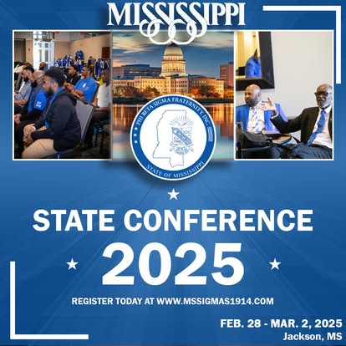

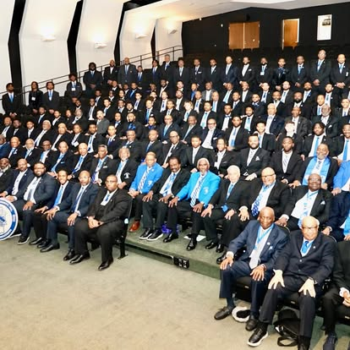
2025 State Conference

Slide 6
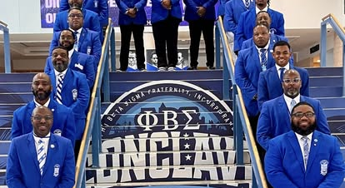
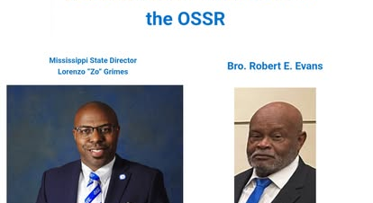
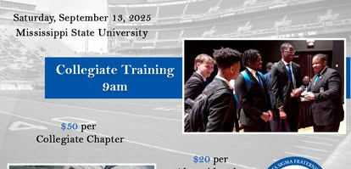
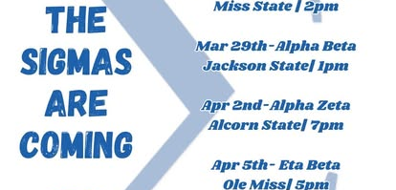

Slide 7
Mississippi Magnolia Club
Alexander, Curtis
Alexander, McKinley
Brown, Harris
Brown, Joseph
Camper, Larry
Carlisle, Glennie
Clark, Jermal
Crockett, Lawrence
Crump, McKenizie
Dale, Willie
Evans, Robert
Foster, Emmitt
Gailes, Charles
Gentry, Charles
Gentry, Roosevelt
Greenwood, Roosevelt
Gowdy, Otis
Hardy, John
Harper, Johnny
Hendricks, Melvin
Jasper, Vernon
Johnson, Silvanus
Kincaid, Robert
Kimes, Frank
Levy, Leroy
Love, Clarence
Mitchell, Chaulk
Montgomery, Benny
Norwood, Sollie
Newell, Willie
Payton, Eddie
Peters, Clifton
Powe, Marshall
Prather, Eddie
Randolph, Terry
Robinson, James
Smith, Lester
Taylory, Clarence
Tillman, Charles
Walker, Randolph
Ward, Nervelle
Wilkins, Jimmy
Wise, Mark
Vaughn, Celois

Slide 8
Strengthening Brotherhood, Securing the Legacy
Invest in Leadership Development
Offer state-level training for chapter presidents, vice presidents, treasurers, and intake leadership.
Offer collegiate and alumni annual leadership retreat.
Continued growth of SBC

Slide 9
Strengthening Brotherhood, Securing the Legacy
Elevate Membership Experience & Retention
Promote intentional brotherhood programming
Encourage chapters to track and re-engage inactive brothers.
Support strong alumni involvement and multigenerational engagement.

Slide 10
Strengthening Brotherhood, Securing the Legacy
Strengthen Financial Health
Encourage timely dues collection and proper budgeting.
Provide financial training for treasurers.
Promote statewide fundraising initiatives or sponsorship opportunities.

Slide 11
Strengthening Brotherhood, Securing the Legacy
Improve Communication & Transparency
Send a monthly State Director update (email or newsletter).
Hold regular town halls so brothers feel heard.
Be transparent about decisions, finances, and challenges.
Be visible.

Slide 12
Strengthening Brotherhood, Securing the Legacy
Standardize Best Practices Across Chapters
Create toolkits for:
  Chapter operations
  Intake processes
  Financial management
  Community service
Share successful chapter programs as models others can replicate.

